Slide 1
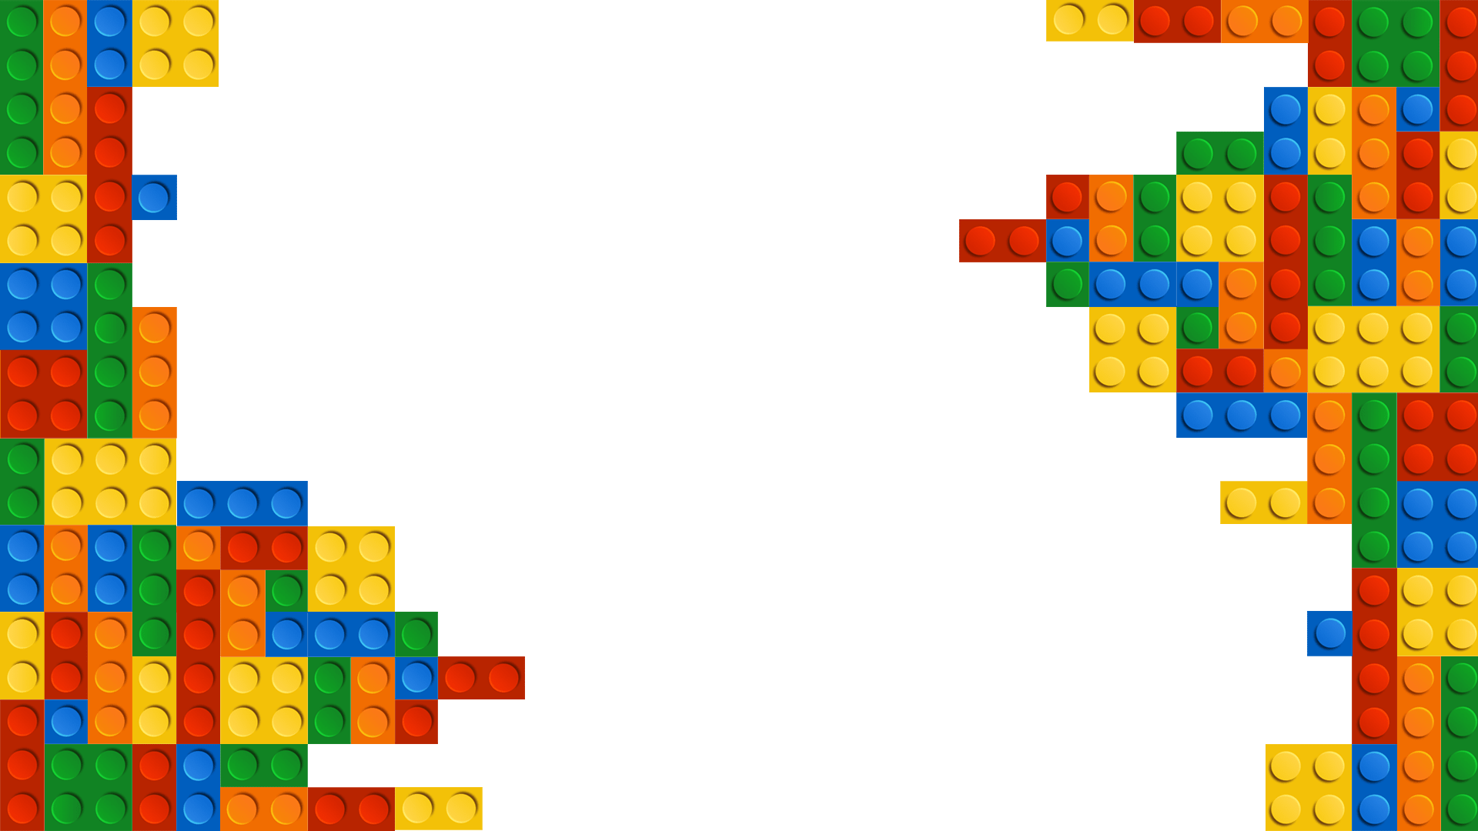


Slide 2
Project objectives and Goals
Goals
Objective
To find the best
combination of factors in a cost- effective way
Maximize the distance traveled by the car

Slide 3
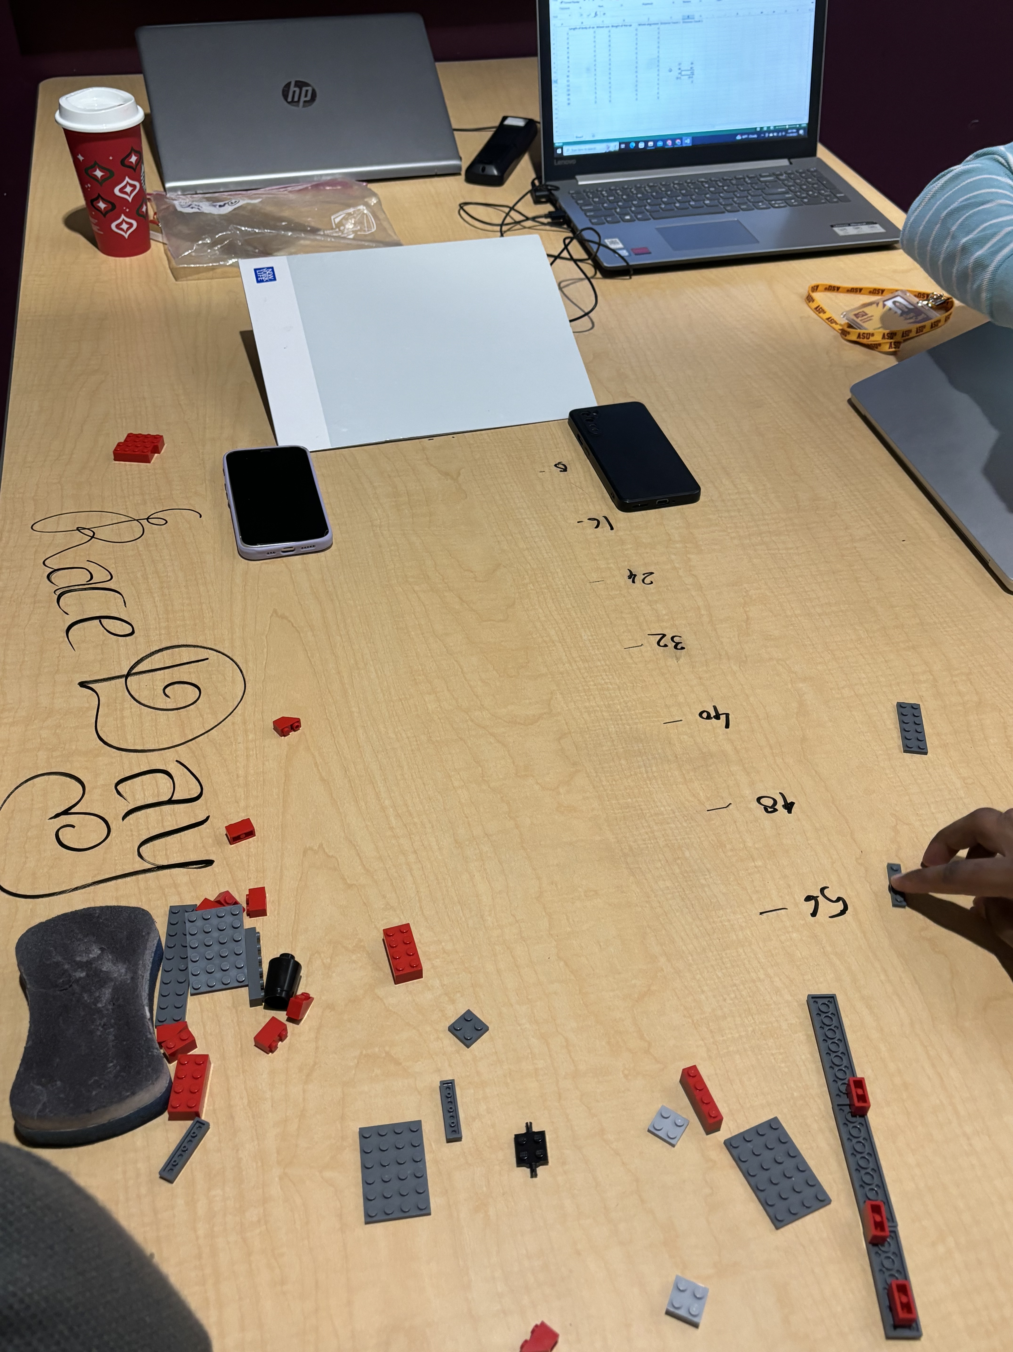

Description of experiment
Experiment Setup
- 4 Factors
- 2 Replications
RAMP
Ramp
- Books and a cardboard
Response Variable
- Distance – Measuring tool: Ruler
Control Method
- Randomizing the factors and replications
- Stable Ramp

Slide 4
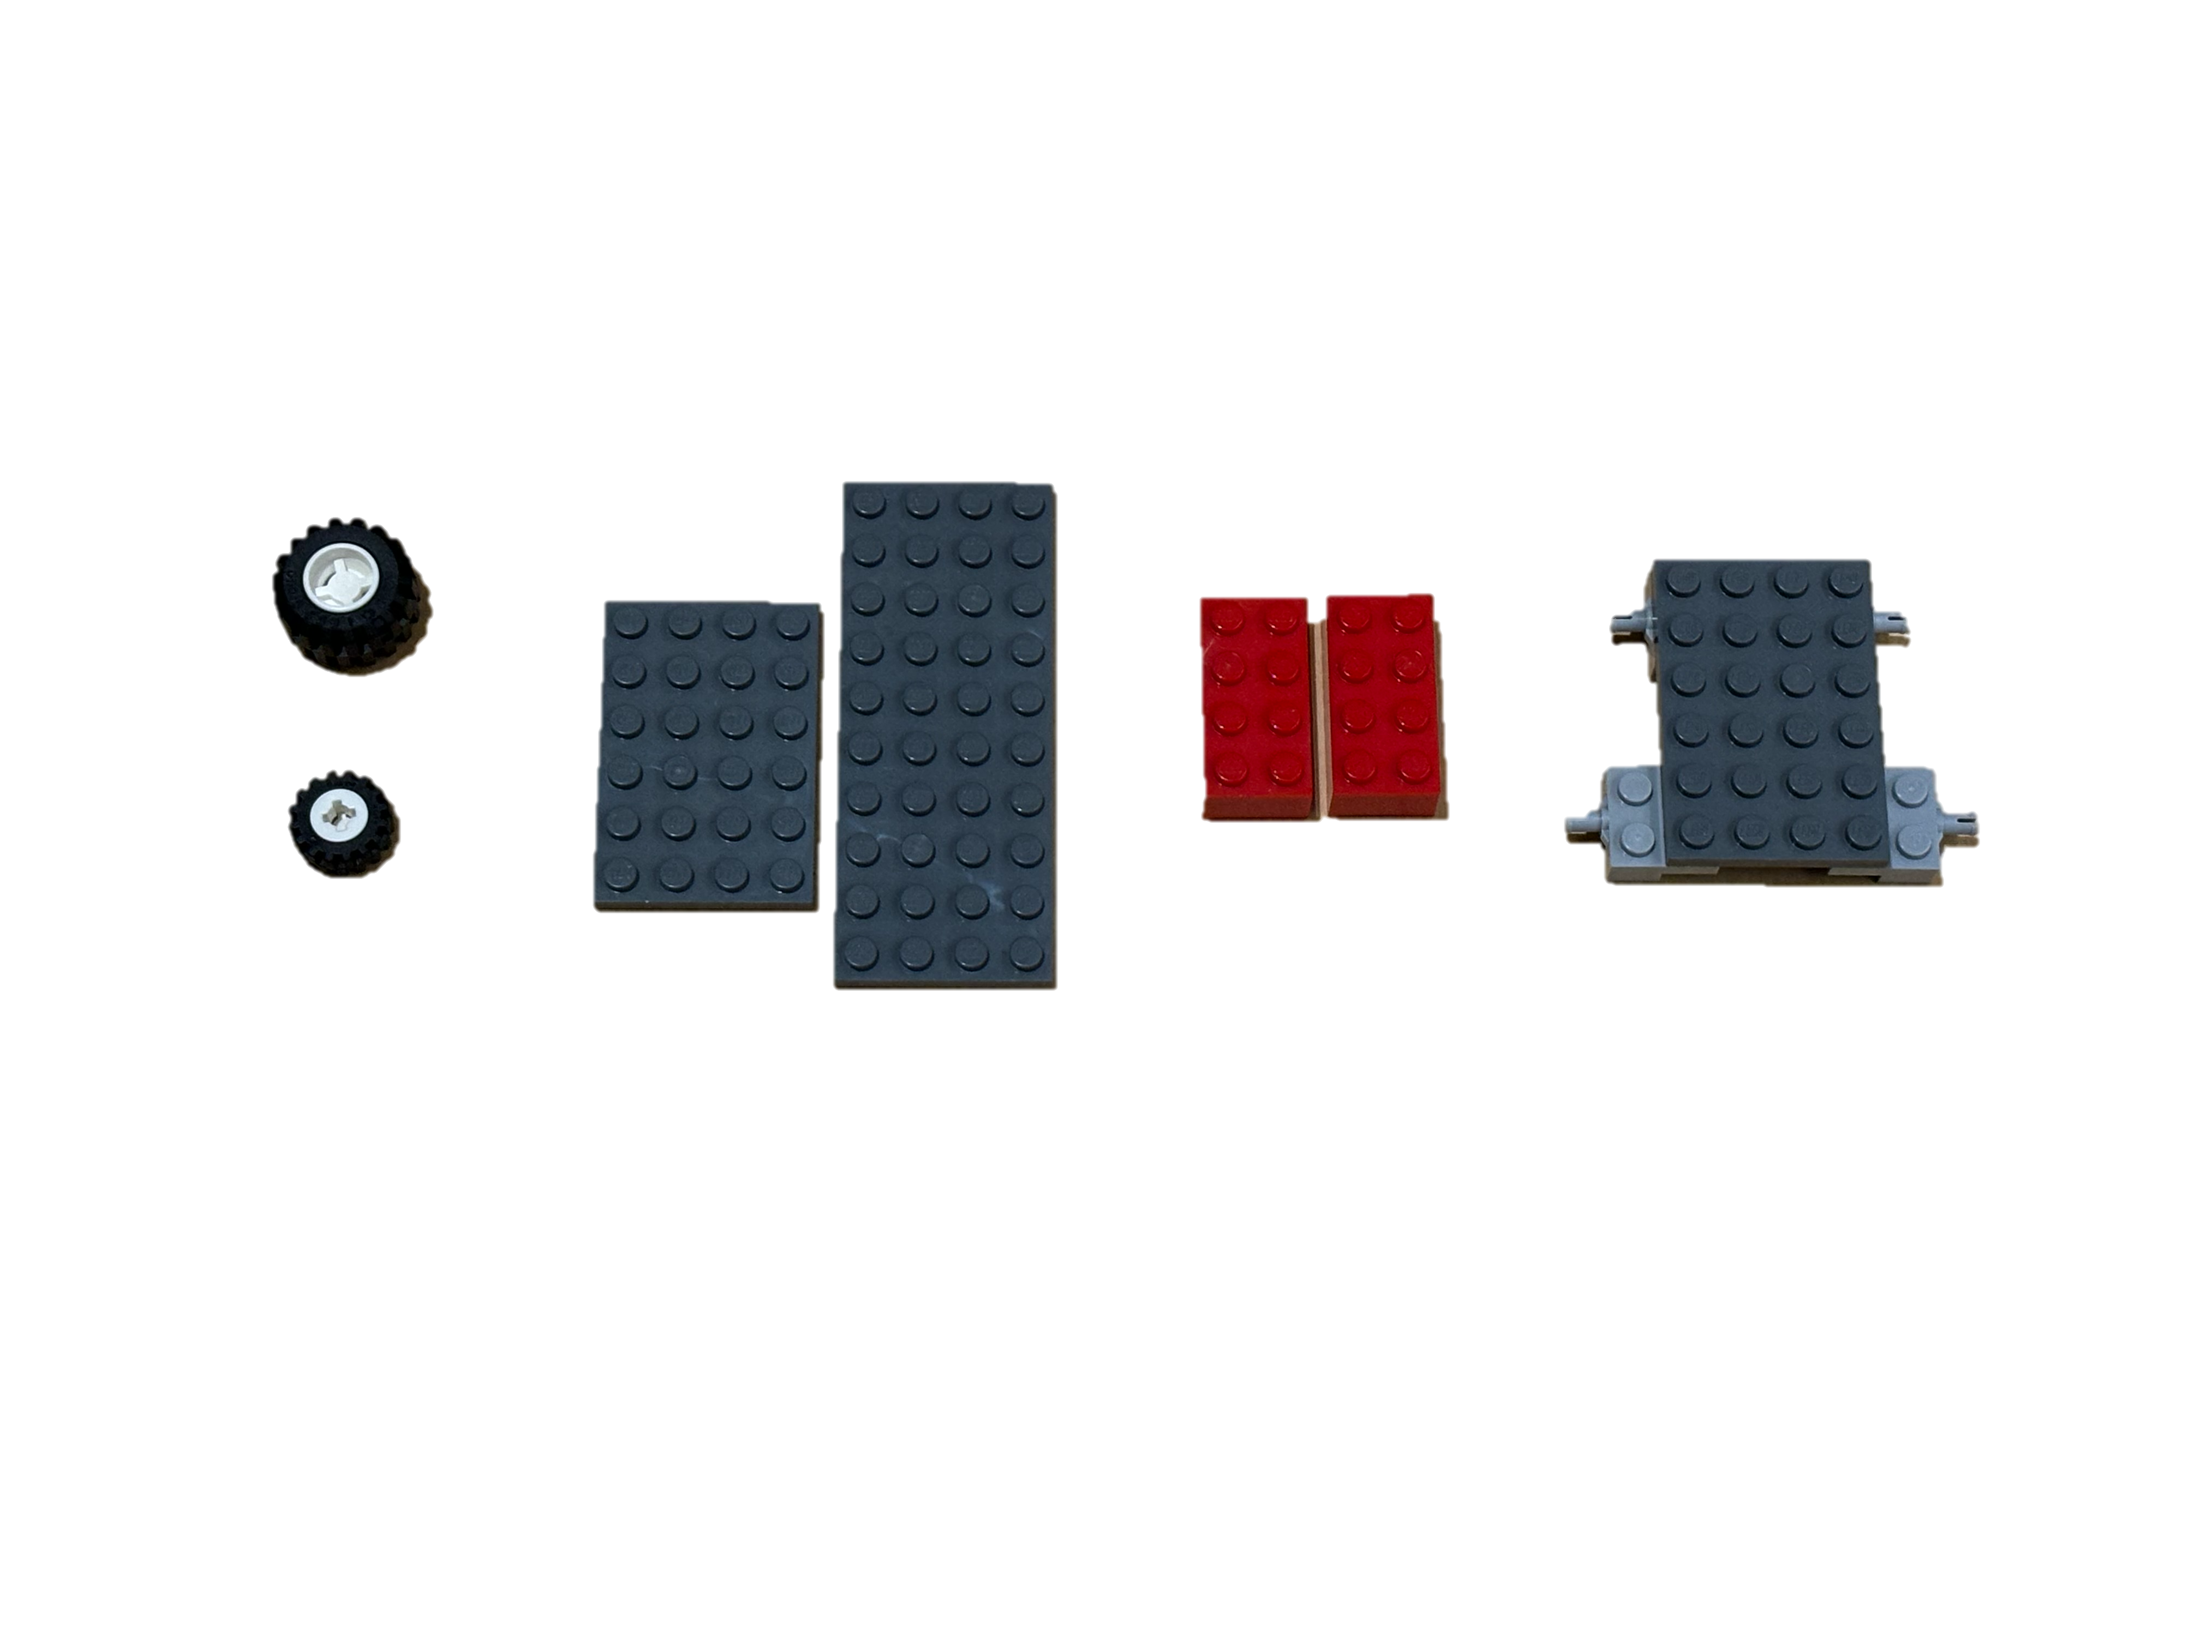
. Project objectives and goals 3. Description of your experimental setup, including how you conducted the experiment, where etc. 4. Factors chosen and a description of each factor. The thought process behind the selection of the factor. 5. Response variable and how you measured it. 6. Choice of experimental design and experimental approach in general. How did you perform the experiment? How did you block any noise parameters etc.? 7. Data Analysis and model adequacy checks, including residual analysis to ensure model assumptions are not violated. 8. Graph demonstrating the results from the experiments and any insight that you may have acquired. 9. A Financial Analysis based on the design of the car and its performance. Are there any trade-offs. Are there any alternatives you would recommend to be more cost effective? 10. Final conclusion and recommendations. Note: The cost associated with each component is provided in the Bill of Material. Based on the cost of various designs, is there a recommendation that maximizes the distance the car traveled while being cost effective? What are your recommendations? Finally, be creative! Take the experiment seriously and use this time to learn how to conduct a DOE. Most importantly, have fun!
Factors
A
B
C
D
Body
Wheels
Weight
Wheel Alignment
Short/Long
Small/Big
Light/Heavy
Closer/Farther
“Distance"
4. Factors chosen and a description of each factor.
The thought process behind the selection of the factor.

Slide 5
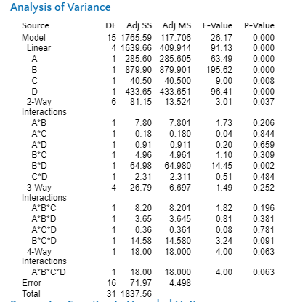
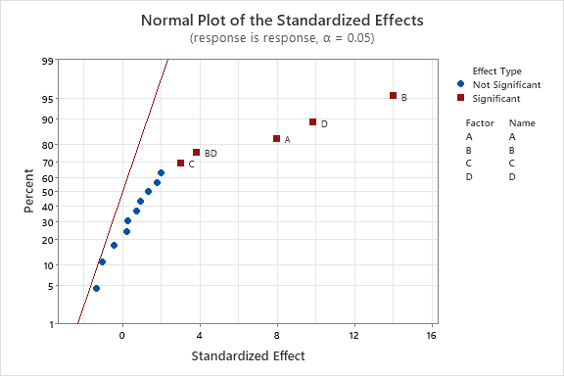
Experiment Analysis
Significant
ANOVA
4 main effects & B*D(Wheels & Alignments)
Normal Plot
7. Data Analysis and model adequacy checks, including residual analysis to ensure model assumptions are not violated.
8. Graph demonstrating the results from the experiments and any insight that you may have acquired. 9. A Financial Analysis based on the design of the car and its performance. Are there any trade-offs. Are there any alternatives you would recommend to be more cost effective?

Slide 6
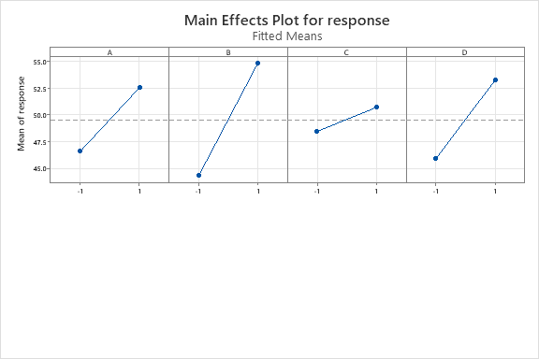
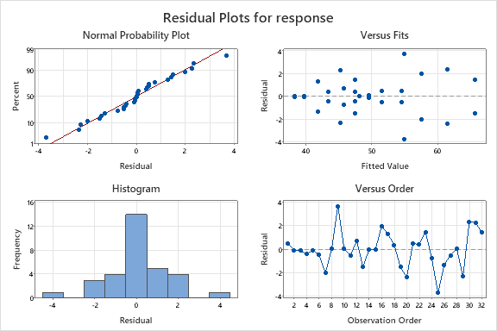
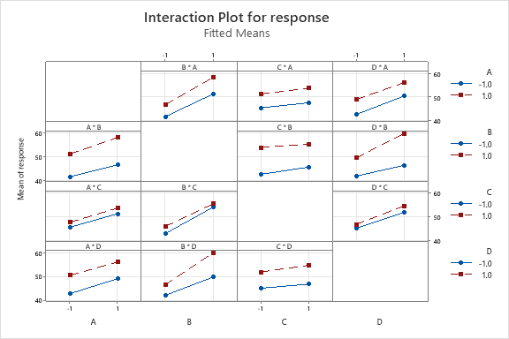
Experiment Analysis
“Normally Independently Distributed”
Wheel Size

Slide 7
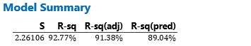
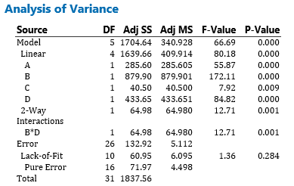
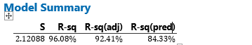
Experiment Analysis
After eliminating non-significant factors

Slide 8
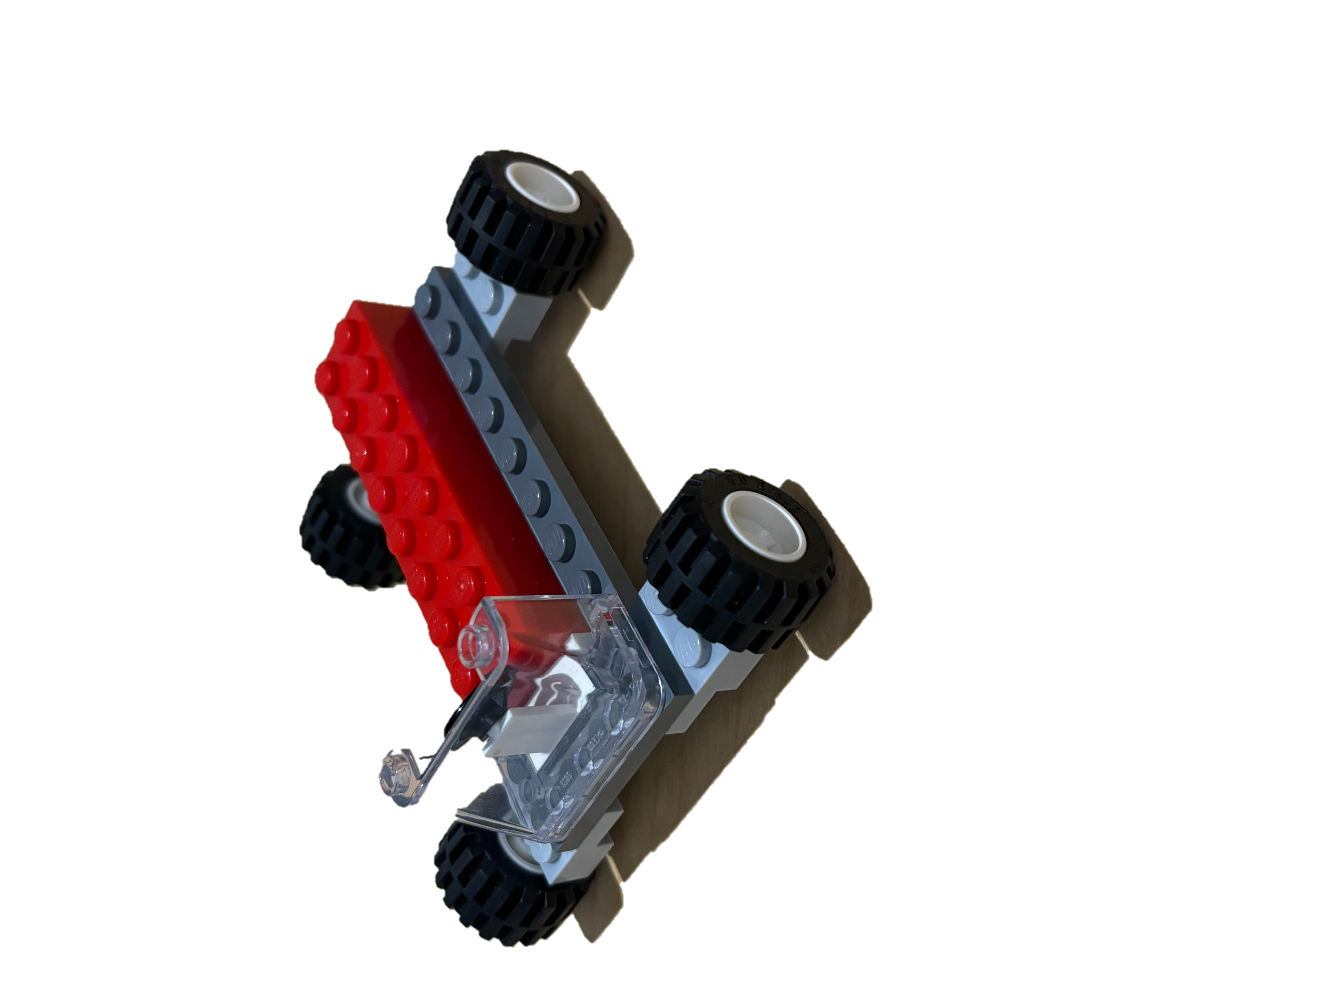
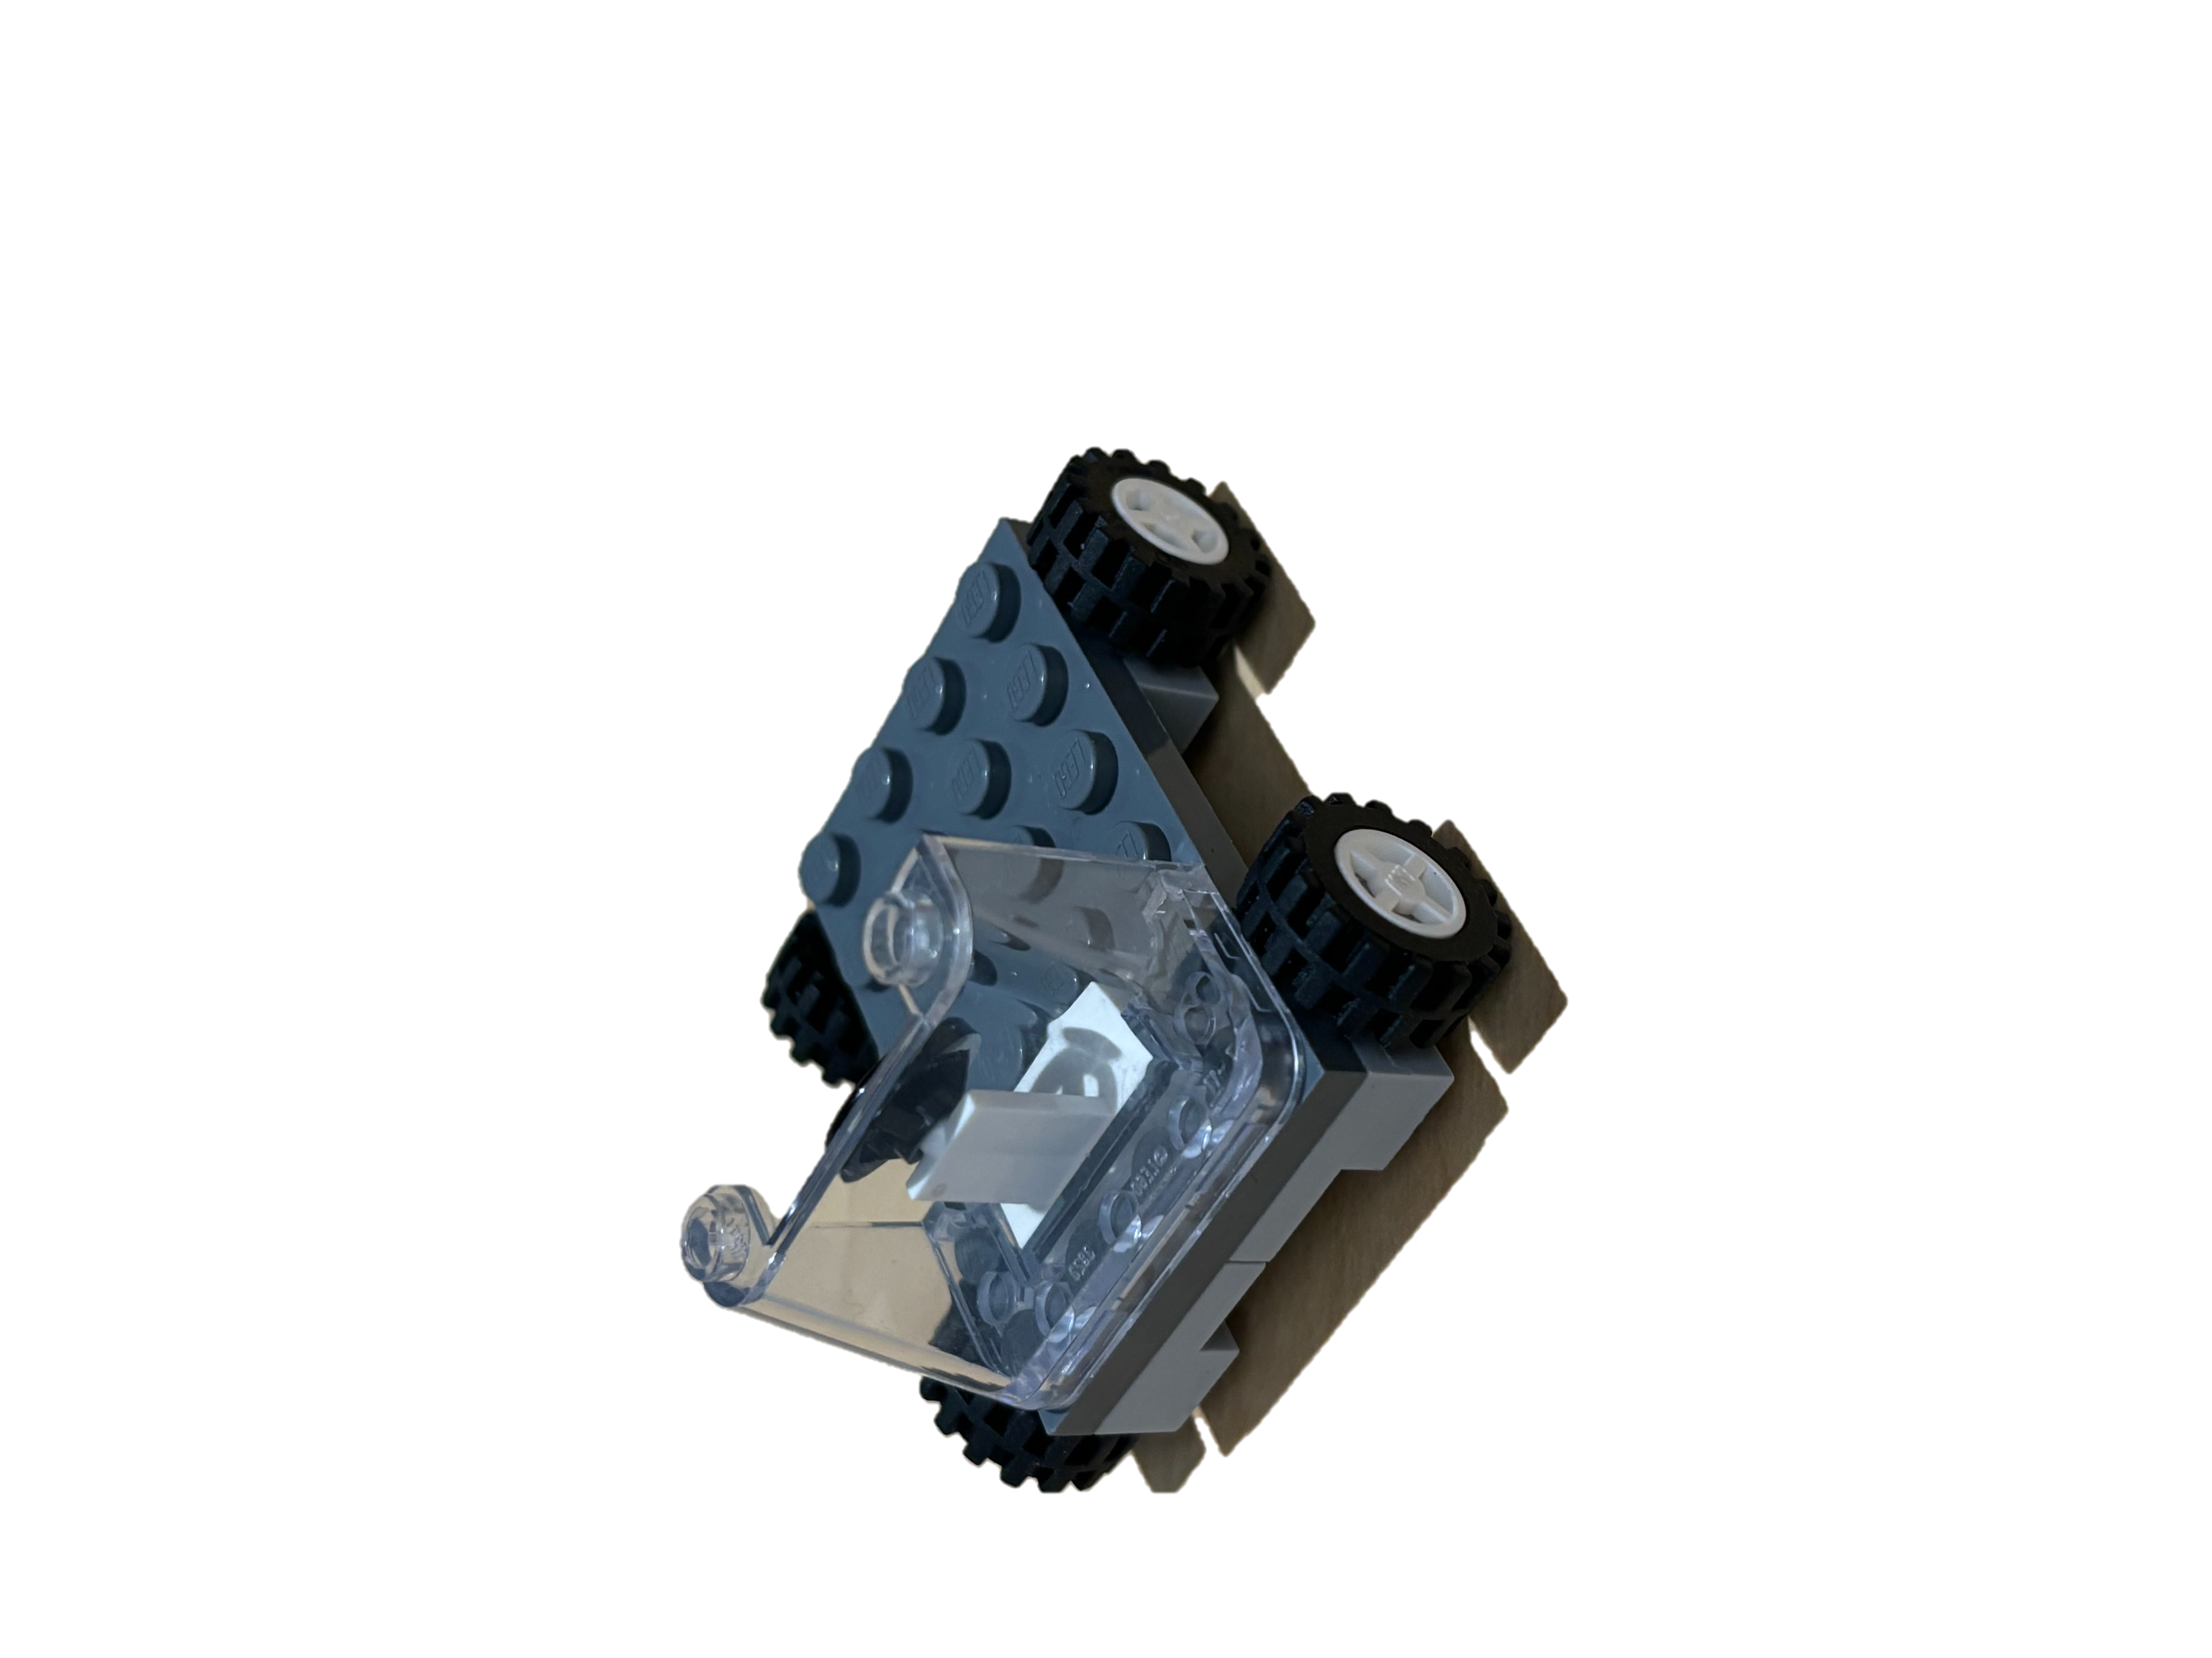
Final Conclusion
Best Car
Extra Load
Worst Car
Factor C(+)
Larger wheels
Factor B(+)
Farther wheel
alignment
Larger Body
Factor D(+)
Factor A(+)

Slide 9
Recommendation
Distance(cm)
Best (abcd) Distance: 65.65
Cost: 15900
Alternative(abd)
Distance: 61.45
Cost: 13900
Trade-Offs
Cost for performance
Cost($)

Slide 10
Thank You

